Slide 1
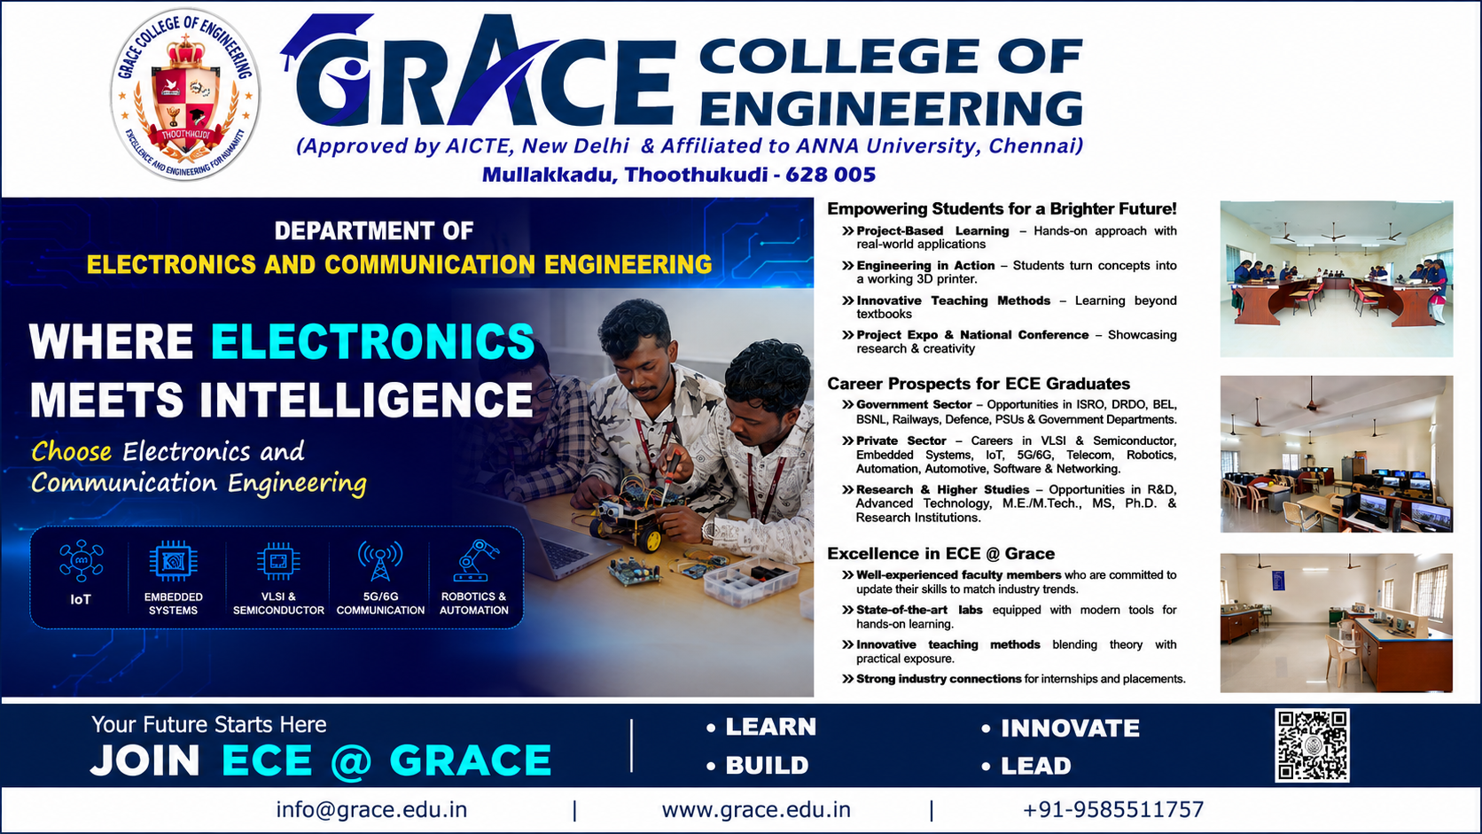

Slide 2
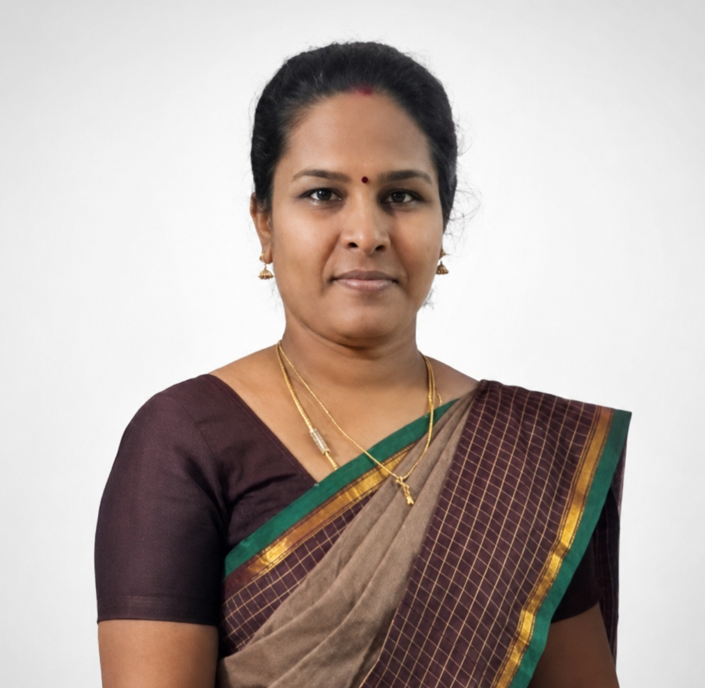
Head of the Department
Mrs. E.M.Uma Selvi
Assistant Professor & Head of the Department,
Department of Electronics and Communication Engineering
M.E. Communication Systems | 14+ Years Experience

Slide 3
About Department
Placement: 94.4% Placement Success in the last academic year – 17 out of 18 graduating students placed.
Student Innovation – Students designed and developed a 3D printer entirely from scratch.
Technical Symposiums – Active participation of students in various technical symposiums.
Paper Presentations – Students presented technical and research papers at academic events.
Experienced Faculty – Well-experienced and committed faculty providing academic and project guidance.
Advanced Laboratories – Digital Signal Processing, Devices & Circuits, and Linear Integrated Circuits Laboratories equipped with computers, advanced kits, and facilities for hands-on practical learning.
Strong Academic Performance – Our students consistently demonstrate very good academic performance in university examinations
Project-Based Learning – Students apply classroom concepts through design, development and real-world project
LEARN • DESIGN • BUILD • TEST • INNOVATE

